Slide 1
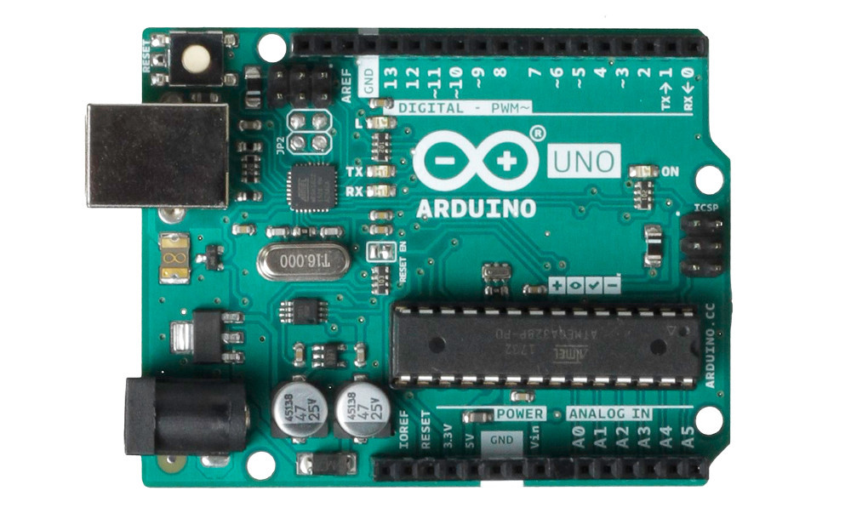

What is Arduino
Arduino is an open source electronic platform that includes hardware and software.
The hardware part is an Arduino board that can be used for circuit connection, and the software part is Arduino IDE which is a program in the computer that used for development.
Software（Arduino IDE）can be downloaded from: https://www.arduino.cc/en/software/
Hardware: Arduino board
Software: Arduino IDE

Slide 2
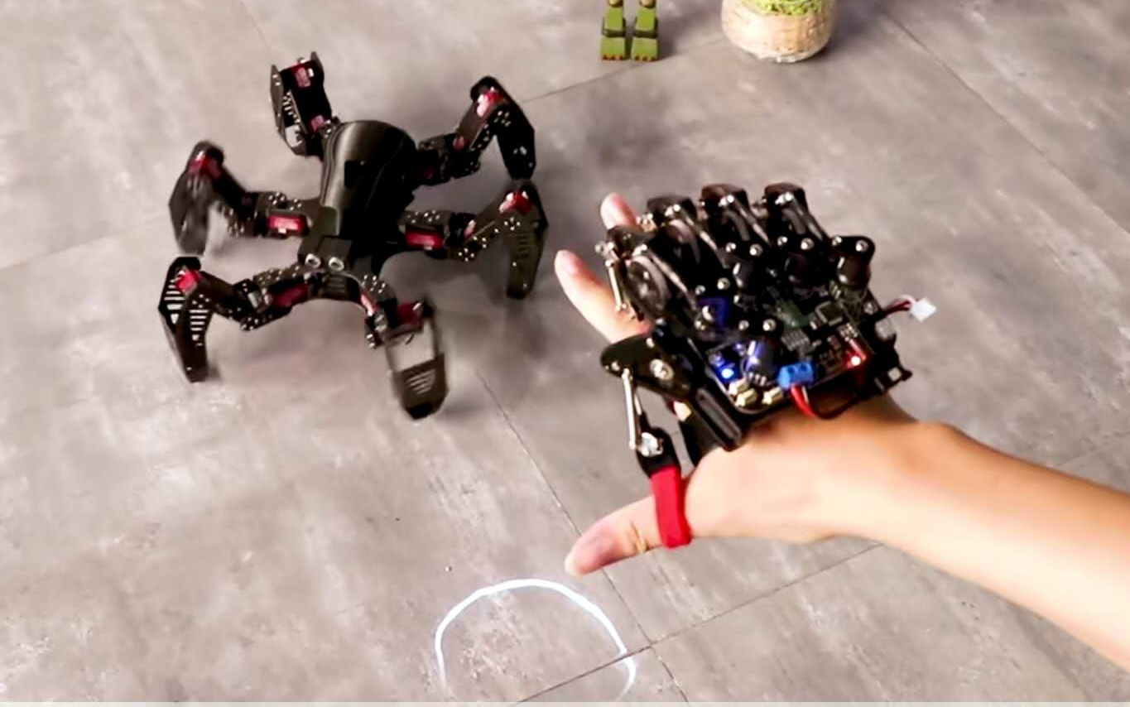
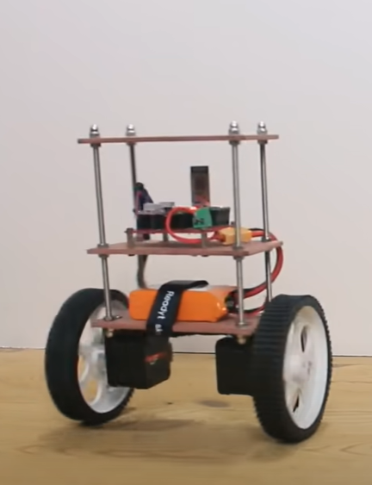
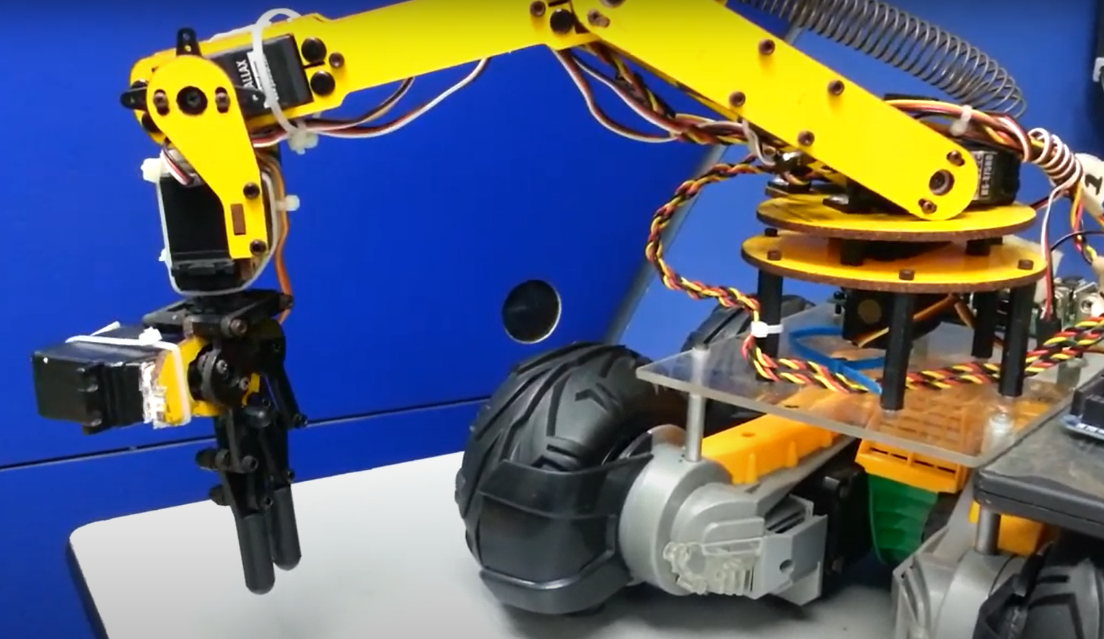
The function of Arduino
Output device
Arduino can use existing electronic components, such as switches, drives or many other sensors to make an interactive device. It can be used to make hardware equipment such as electronic production or creative design prototypes.

Slide 3
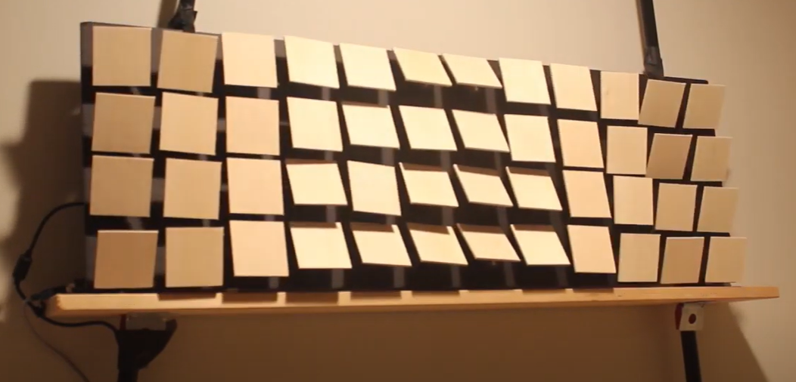
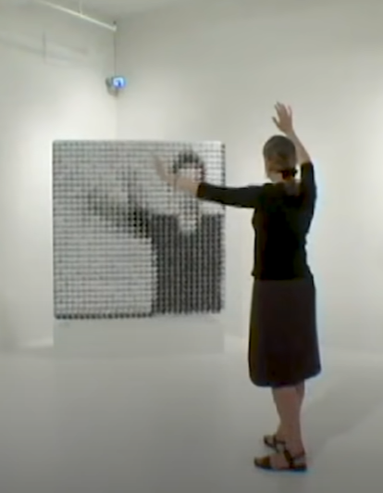
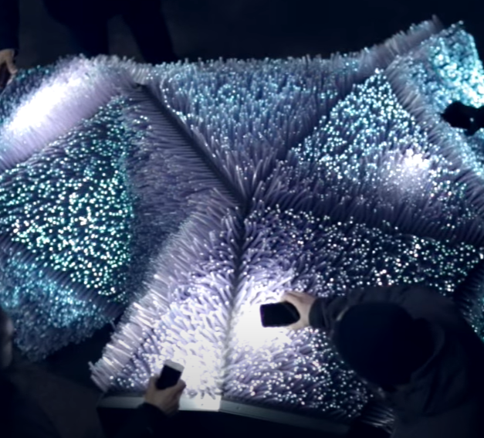
The function of Arduino
Art interactive works
Arduino can also build art interactive works though integrating ideas and sensors in a simple or unified way. Using sensors to sense and affect the environment by controlling lights, motors and other devices. This kind of work can be an original object, a wall, or combined with other objects in life.

Slide 4
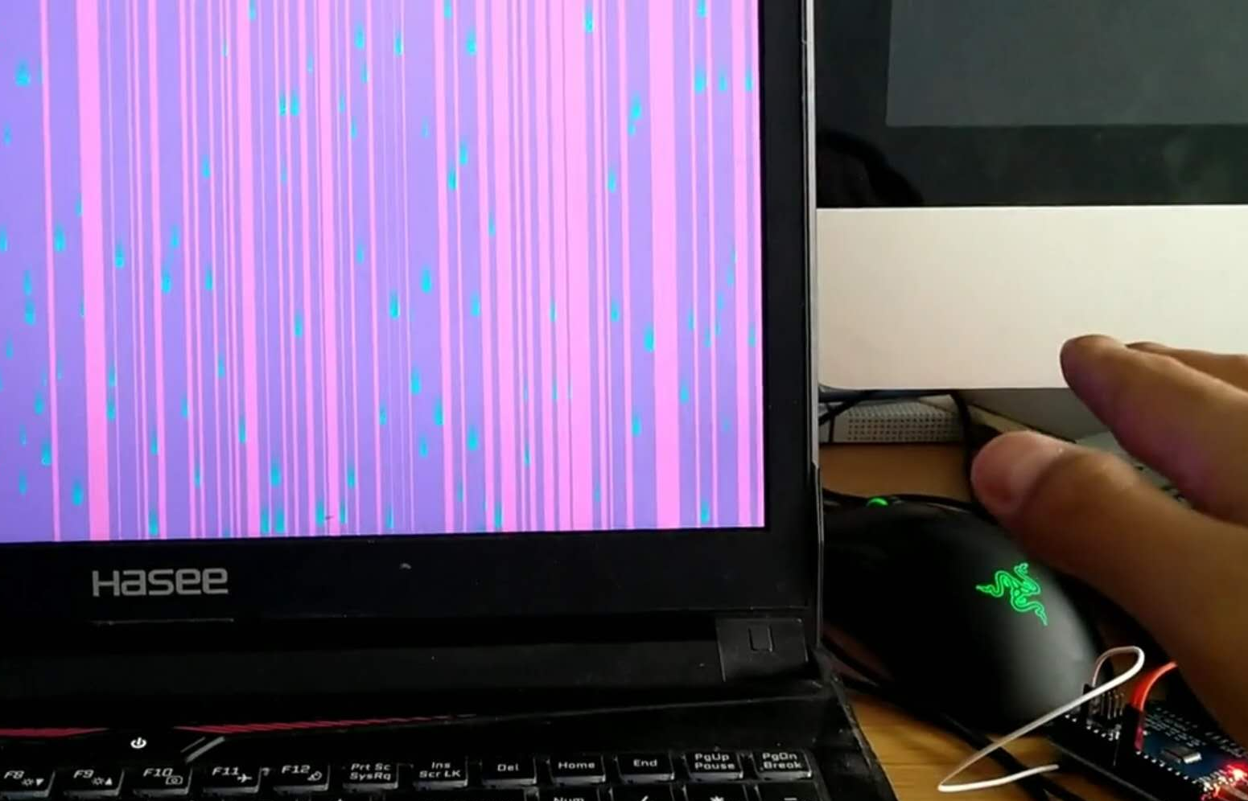
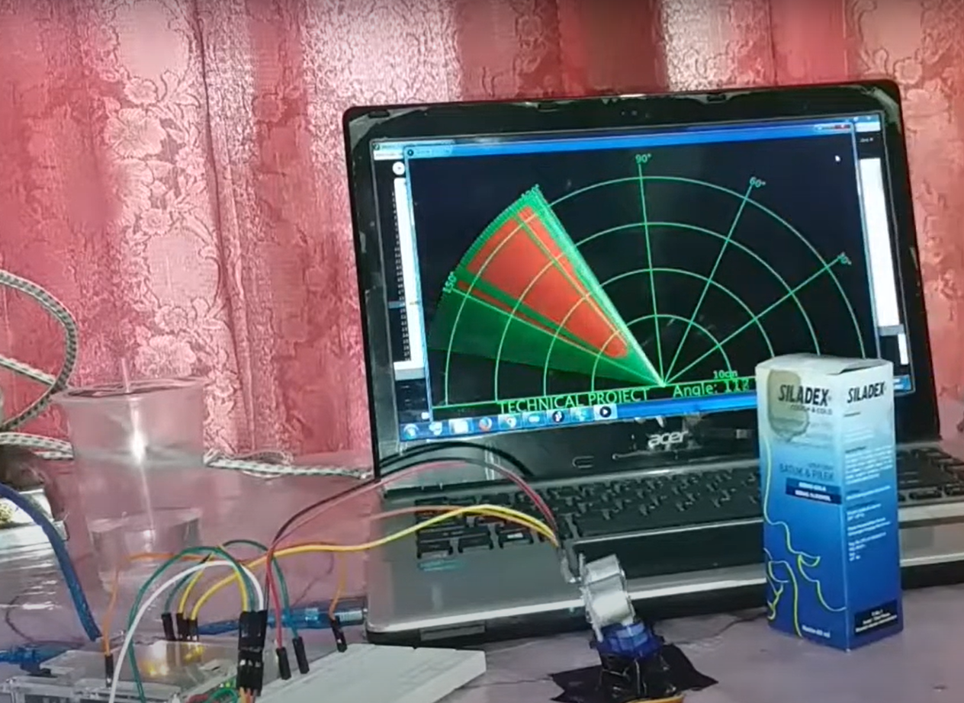
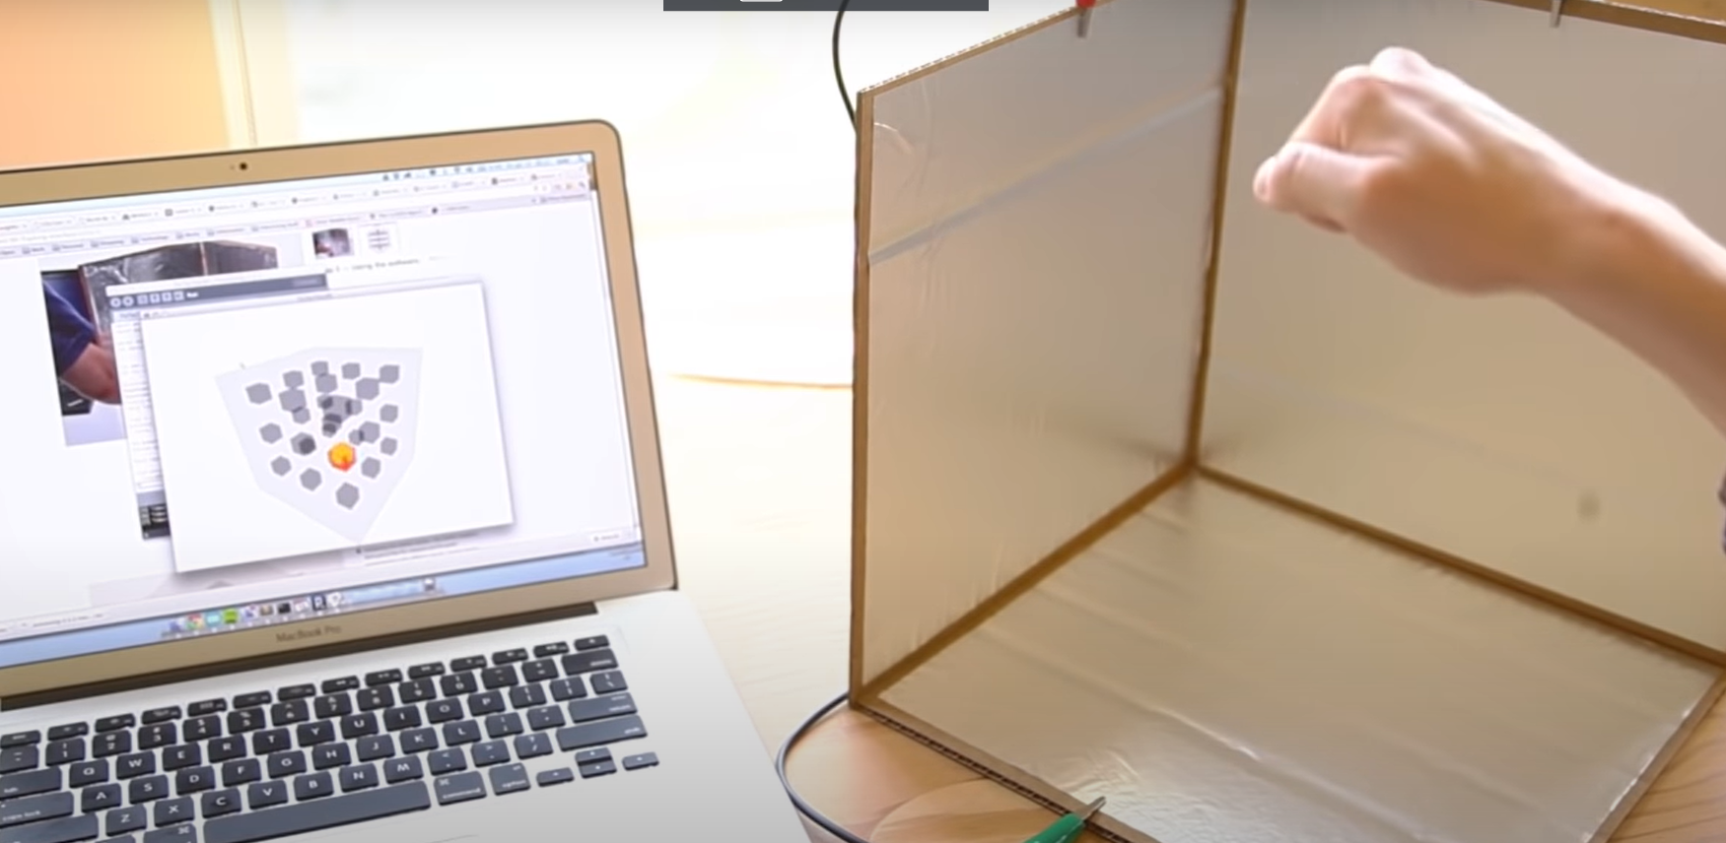
The function of Arduino
Interactive software
Arduino can be used with many software, such as processing, brain-link, etc. Their cooperation can create many interesting visually interactive software or pages. Interaction with the computer is no longer limited to the mouse and keyboard. Sound, infrared, touch, pressure human motion catcher and many other facts can become the input source of the computer.

Slide 5
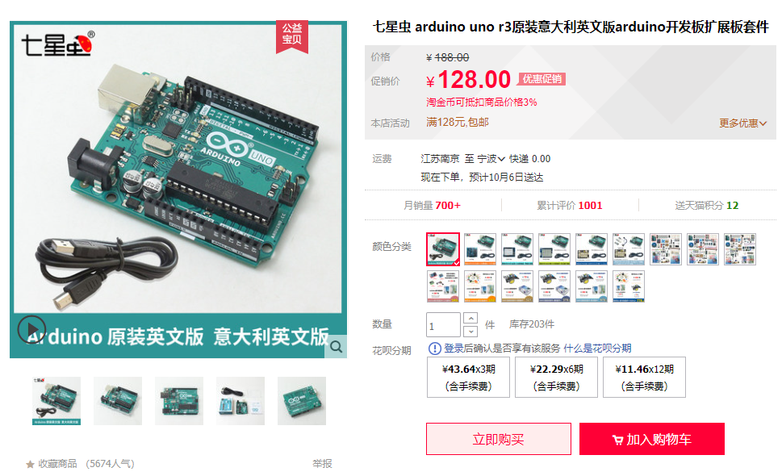
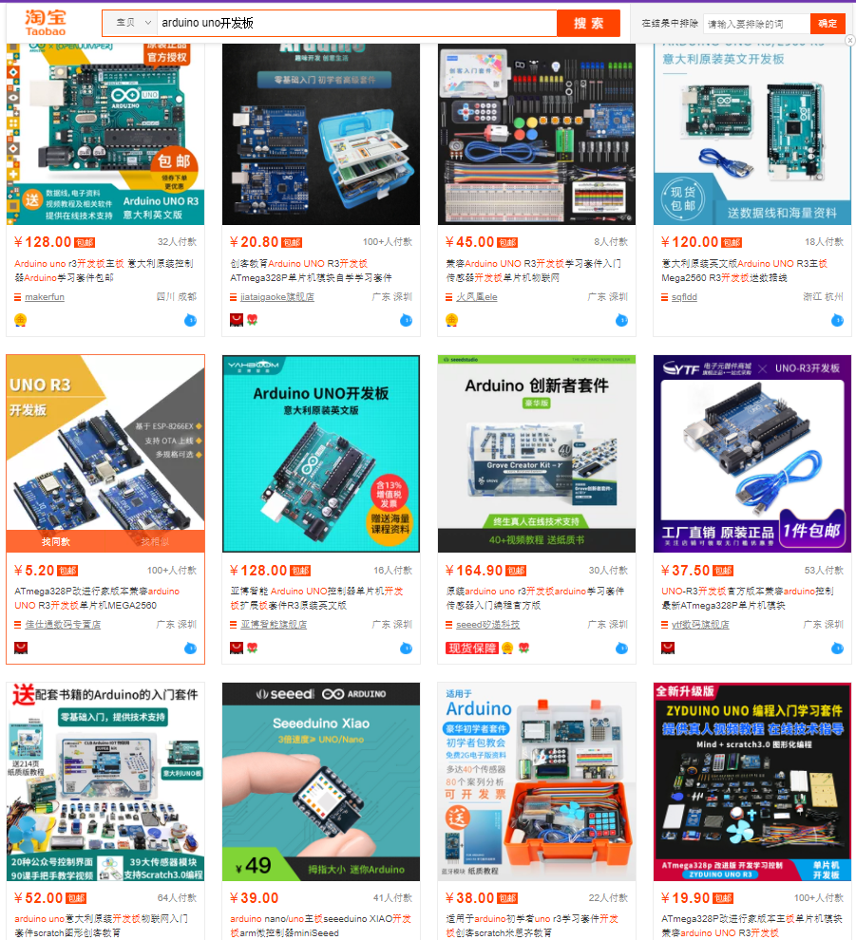
The choice for Arduino
The official Arduino team adopted the Creative Commons license. Anyone is allowed to produce and sell copies of the Arduino development board. Therefore, there are two kinds of development boards, one is the official board, and the other is the clone board of other manufacturers.
Both official boards and clone boards are legal products.
The production process of the official board will be more excellent and more expensive.
Original Italian version
Different styles and prices

Slide 6
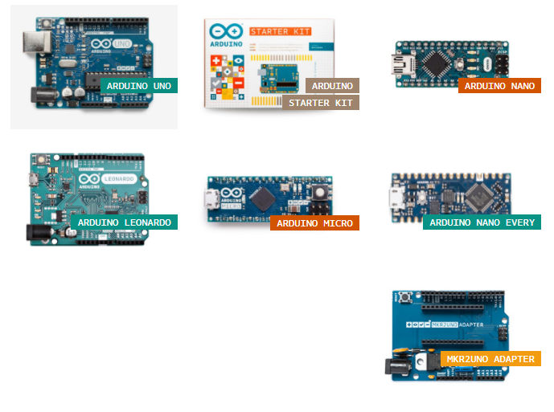
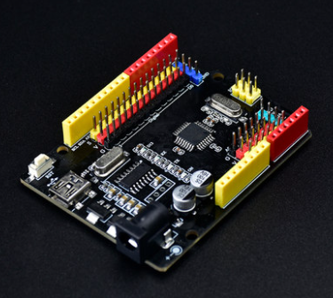
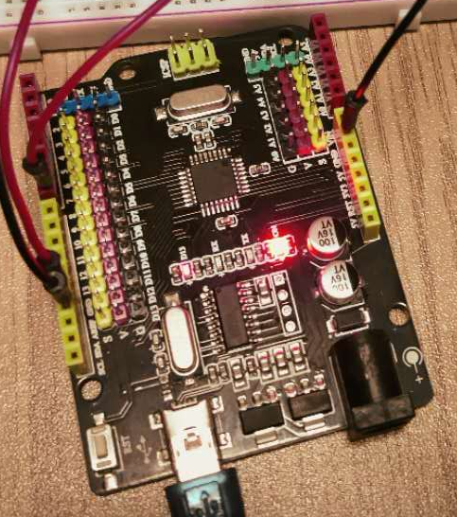
The choice for Arduino
There are many types of Arduino development board, which can be roughly divided into five categories: Entry Level, Enhanced Features, Internet of Things, Education, and Retired.
You can view all of them from the official website: https://www.arduino.cc/en/Main/Products
There are not much options for us, we got only Arduino UNO. We have two pieces in our hands. One is turquoise and the other is black. They are both made in China. We can easily buy them in a cheap price.
Entry Level
Black UNO board we used

Slide 7
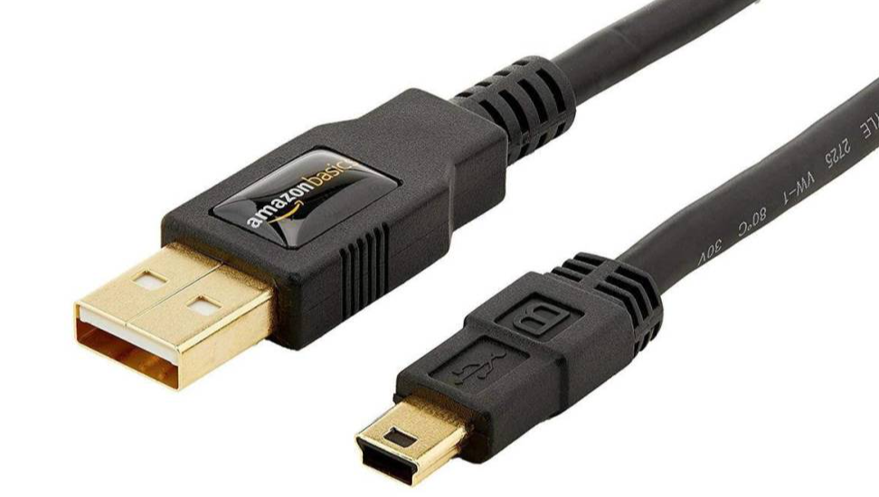
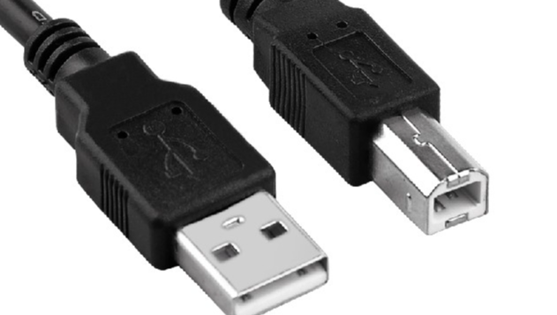
Connection with computer
Wire
Two types of wires in our group

Slide 8
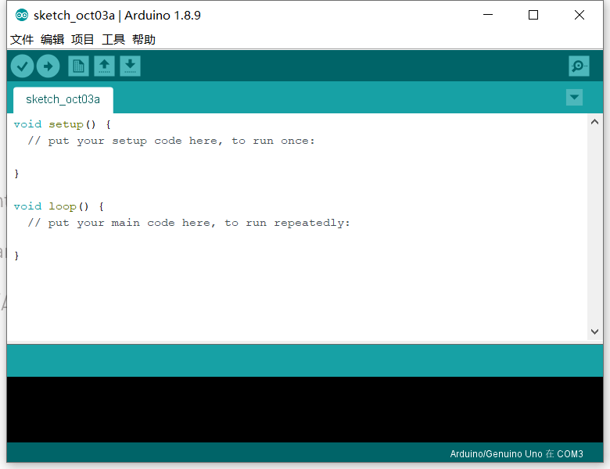
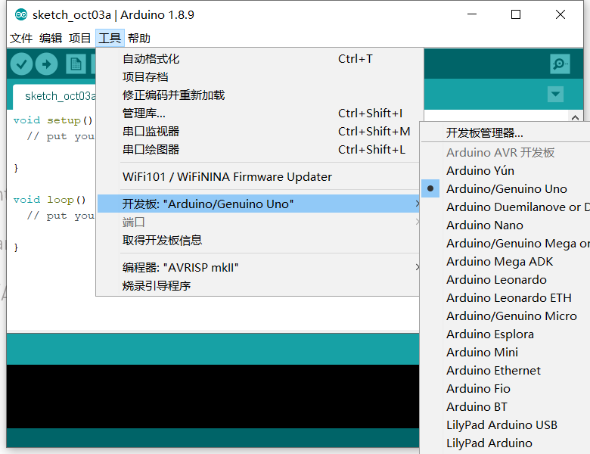
Connection with computer
Development board and port selection
‘Arduino on comX’ is in the lower right corner of the Arduino IDE. X stands for number.
Click the ‘工具 – 开发板’ at the toolbar and choose the Arduino type.
Then select the comX in the ‘工具-端口’.

Slide 9
Web
Circuit drawing at: https://www.tinkercad.com/dashboard
Recommendations for Color-Ring-Resistance calculation: http://www.elecfans.com/tools/

